Slide 1

珠海圖思科軟件有限公司
Tosska Technologies Limited
SQL Tuning
&
Database Design
Richard To
CTO
Richard.to@tosska.COM

Slide 2
What affect System Performance
Wrong Focus
Network
Hardware
O.S.
Database
Application

Slide 3
Handling Performance Problems
CPU + Memory + Hardware + OS/DB upgrade
= 10~20% performance improvement
Re-design of DB structure and applications
(Not feasible to existing system)
OS and DB parameter changes
SQL Performance Tuning

Slide 4
The Nature of SQL
Uses 70% to 90% of system resource
Most significant to application performance
Easy to write but difficult to master
Needs constant optimization due to data and environment changes

Slide 5
How does RDBMS handle SQL?
Server received SQL
Parse
Quest is a highly innovative company focused on helping companies simplify and reduce the cost of managing IT
SQL
RDBMS SQL optimizer
determine the execution path
Data
Bind
Execute

Slide 6
How Database Optimizer Works?
Does it try every possible
way to rewrite your SQL?
Plan 1
Internally rewrites to generates multiple execution plans
Plan 2
Cost
Estimation
SQL
Plan 3
Plan 1 cost=1000
How accurate is
the cost estimation ?
Plan 2 cost=3000
Plan 3 cost= 500
Execution

Slide 7
Can Tianhe-II(天河二号) solve this problem?
If DBMS Optimizer will consider which join path is the best :
Select * from A,B,C,D… /* 25 tables join together */
Where …
Which one is best ?
Permutation = 25! = 25x24x23x22x21x ...
= 15511210043330985984000000
峰值速度（Rpeak）= 54,902.4TFLOPS per second 每秒54,902.4万亿次浮点运算
Assume each permutation use only one computer calculation
Processing time = 215 years

Slide 8
What is SQL tuning?
Same result
SQL
Plans Maze

Slide 9
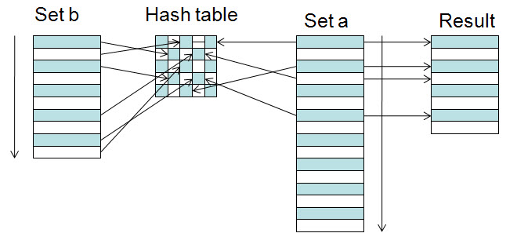
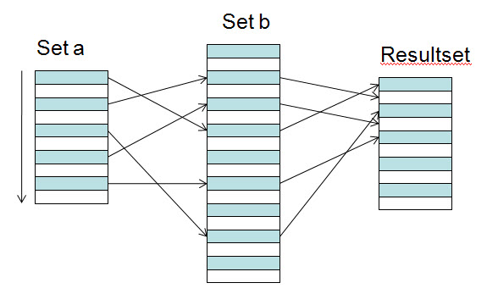
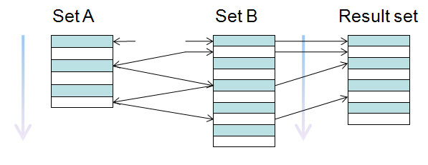
How to process a join table ?
Hash Join
SELECT A.KEY, B.KEY FROM A, B
WHERE A.KEY=B.KEY
Nested Loops
Merge Join

Slide 10
Cost of Nested Loop Joins
Consider the nested loop situation
(calculate the total number of operations only)
N(A) = 10,000,000 records N(B) = 1,000 records
N(A)*Ln(N(B))/2 =
10,000,000*Ln(1,000)/2=34,538,776
N(B)*Ln(N(A))/2 =
1000*Ln(10,000,000)/2=8,059
Full Scan
A
Index Scan
A
Index Scan
B
Full Scan
B

Slide 11
EXIST or IN
Using EXIST or IN
SELECT *
FROM A
WHERE A.CITY IN (SELECT B.CITY FROM B)
SELECT *
FROM A
WHERE EXISTS (SELECT ‘X’ FROM B
WHERE B.CITY = A.CITY)

Slide 12
Table Join versus Sub-Query
Table join is normally better than sub-query ?
Original
SELECT *
FROM A
WHERE A.CITY IN (SELECT B.CITY
FROM B)
Rewrite or not ?
SELECT A.*
FROM A, B
WHERE A.CITY = B.CITY
SELECT *
FROM A
WHERE EXISTS (SELECT ‘X’
FROM B WHERE A.CITY=B.CITY)

Slide 13
Enable using of index
select * from employee where emp_id + 10 = 121212
select * from employee where emp_id =121212 - 10
select * from employee where ifnull(emp_id,0)=121212
select * from employee where emp_id = 121212

Slide 14
How to build indexes ?
SELECT *
FROM A
WHERE A.CITY IN (SELECT B.CITY
FROM B)
SELECT A.*
FROM A, B
WHERE A.CITY = B.CITY
A
B
B.CITY
B
A
A.CITY
A.CITY
A
B
B.CITY

Slide 15
How to build indexes ?
SELECT A.*
FROM A
WHERE A.CITY = ‘Zhuhai’
AND A.COUNTRY=‘China’
AND A.PROVINCE=‘Guangdong’
Index candidates
A.CITY
A.COUNTRY
A.PROVINCE
Composite Indexes
A.CITY,A.COUNTRY
A.CITY,A.PROVINCE
A.COUNTRY,A.PROVINCE
A.COUNTRY,A.CITY
A.PROVINCE,A.CITY
A.PROVINCE,A.COUNTRY
A.CITY,A.COUNTRY,A.PROVINCE
A.CITY,A.PROVINCE,A.COUNTRY
A.COUNTRY,A.CITY,A.PROVINCE
A.COUNTRY,A.PROVINCE,A.CITY
A.PROVINCE,A.CITY,A.COUNTRY
A.PROVINCE,A.COUNTRY,A.CITY

Slide 16
创建会议时随机生成一个5位的整数作为新建会议的ID，要求该会议ID在最近5天内不重复
会议ID记录表记录100万条； 随机获取一行
PRIMARY KEY (`ConfIdInt`),
SELECT ConfIdInt FROM ConfInfo
WHERE IsOccupied = 0 AND ConfIdInt < 100000
AND UNIX_TIMESTAMP(date(last_used_time)) < UNIX_TIMESTAMP(DATE_SUB(date(now()), INTERVAL 5 DAY))
order by rand() limit 1
Rewrite to:
SELECT ConfIdInt FROM ConfInfo
WHERE IsOccupied = 0 AND ConfIdInt < 100000
AND last_used_time <TIMESTAMPADD(day,-5,CURTIME())
order by rand() limit 1

Slide 17
SELECT ConfIdInt FROM ConfInfo
WHERE IsOccupied = 0 AND ConfIdInt < 100000
AND last_used_time <TIMESTAMPADD(day,-5,CURTIME())
order by rand() limit 1
If sorting take too much time try following:
select @rownum:=0;
CREATE TEMPORARY TABLE tempT
select ConfIdInt, @rownum:=@rownum+1 row_num FROM ConfInfo
where IsOccupied = 0 AND ConfIdInt < 100000
AND last_used_time <TIMESTAMPADD(day,-5,CURTIME());
select @randnum:=floor(rand()*@rownum+1);
select emp_id from tempT where row_num = @randnum;
drop temporary table tempT;

Slide 18
How to control the join Path?
select * from A,B where A.key = B.key
select * from A,B where A.key + 0 = B.key
A
B
A
B

Slide 19
How to control three tables join ?
select * from A,B,C where A.key = B.key and B.key = C.key and A.f1 = :VAR
select * from A,B,C where A.key + 0 = B.key and B.key + 0= C.key and A.f1 = :VAR
VAR
A
B
C
VAR
A
B
C

Slide 20
Transformation rules relating to index usage
Example 1
select *
from employee
where (emp_id > :c or :c is null)
and (emp_id < :d or :d is null)
select * from employee where (emp_id >IFNULL(:c, -1E9))
and (emp_id <IFNULL(:d, 1E9))
Transforms to
Example 2
select *
from employee
where (emp_id >:c or :c is null)
and (conditions)
select * from employee where (emp_id > IFNULL(:c, -1E9))
and (conditions)
Transforms to

Slide 21
Sub-query with group by?
Example for all platforms
select * from A
where A.key in
(select B.key from B)
Transforms to
select * from A
where A.key in
(select B.key from B
group by B.key)
A lot of duplicated B.key return from subquery
Control the driving path from B to A
Remark
The transformation is valid only if there are no Group, Set, or User-defined stored functions call in the IN sub-query

Slide 22
Some special techniques 3
Control join path for subquery
SELECT *
FROM department
Where dpt_id in (select emp_dept
from employee
where emp_name < 'B')
and dpt_name < 'D'
Rewrite to :
SELECT *
FROM department
Where dpt_id in (select emp_dept
from employee
where emp_name < 'B')
and dpt_name < 'D'
||''
SELECT department.*
FROM department,employee
Where dpt_id = emp_dept||’’
and emp_name < 'B'
and dpt_name < 'D'

Slide 23
Transitivity Improvement 1
Select * from A,B,C
where A.key=B.key
and B.key=C.key
and C.key=‘text’
and A.key=C.key
and A.key=‘text’
and B.key=‘text’
Select * from A,B,C
where A.key=B.key
and B.key=C.key
and C.key=‘text’

Slide 24
Transitivity Improvement 2
Select * from A
where A.key IN (select B.key from B)
and A.key<2000
Select * from A
where A.key exists (select B.key from B
where B.key<2000)
and A.key<2000

Slide 25
Transitivity Improvement Example
(select A.AnsUserID,A.CfgDateIndex,B.CfgName,A.Sequence from AnsDateStrategy where TenantID='880050' ) A
left join
(select * from DatetimeCfg where TenantID='880050') B
on A.CfgDateIndex=B.AID
where A.TenantID='880050' and A.StrategyID='83' order by A.Sequence asc
Rewrite to:
(select A.AnsUserID,A.CfgDateIndex,B.CfgName,A.Sequence from AnsDateStrategy where TenantID='880050' and StrategyID='83') A
left join
(select * from DatetimeCfg where TenantID='880050') B
on A.CfgDateIndex=B.AID
where A.TenantID='880050' and A.StrategyID='83' order by A.Sequence asc

Slide 26

Enable Index Merge
SELECT A.*
FROM A
WHERE A.CITY = ‘Zhuhai’
OR A.COUNTRY=‘China’
OR A.PROVINCE=‘Guangdong’
SELECT A.*
FROM A
WHERE A.CITY = ‘Zhuhai’
OR A.COUNTRY=‘China’
OR A.PROVINCE IN (SELECT B.PROVINCE FROM B
WHERE AVG(B.POPULATION > 2000000)
Rewrite to :
SELECT A.*
FROM A
WHERE A.CITY = ‘Zhuhai’
OR A.COUNTRY=‘China’
UNION
SELECT A.*
FROM A
WHERE A.PROVINCE IN (SELECT B.PROVINCE FROM B
WHERE AVG(B.POPULATION > 2000000)

Slide 27
Example
SELECT distinct t.username FROM ofUser as t
INNER JOIN
(SELECT username FROM ucTenementMember
WHERE (tenementId IN ('880001'))) AS tm ON t.username = tm.username
WHERE (t.username NOT IN (('u1000014','u1000148'))
AND (status!='lock')
AND (t.username in (SELECT username FROM ofUser
WHERE (t.username='查询字符串')
OR (customId='')
OR (phone='')
OR (email='查询字符串')
OR (sipAccount='查询字符串')
OR (name LIKE '查询字符串')
OR (username in(SELECT username FROM ucVCardItem
WHERE (itemId='extTelephone'
AND value='5002' AND tenementId='880006')
)
))) LIMIT 1,10

Slide 28
SELECT username FROM ofUser
WHERE (t.username='查询字符串')
OR (customId='')
OR (phone='')
OR (email='查询字符串')
OR (sipAccount='查询字符串')
OR (name LIKE '查询字符串')
OR (username in(SELECT username FROM ucVCardItem
WHERE (itemId='extTelephone'
AND value='5002' AND tenementId='880006'
SELECT username FROM ofUser
WHERE (t.username='查询字符串')
OR (customId='') OR (phone='')
OR (email='查询字符串')
OR (sipAccount='查询字符串')
OR (name LIKE '查询字符串')
UNION
SELECT username FROM ofUser
WHERE (username in(SELECT username FROM ucVCardItem
WHERE (itemId='extTelephone' AND value='5002'
AND tenementId='880006') /*composite index may need */

Slide 29
Use Query Hints to Control Query Plan
USE {INDEX|KEY}
[{FOR {JOIN|ORDER BY|GROUP BY}] ([index_list])
| IGNORE {INDEX|KEY}
[{FOR {JOIN|ORDER BY|GROUP BY}] (index_list)
| FORCE {INDEX|KEY}
[{FOR {JOIN|ORDER BY|GROUP BY}] (index_list)
SELECT artist_id, name, country_id
FROM artist USE INDEX (type)
WHERE founded = 1980 AND type='Band'
SELECT artist_id, name, country_id
FROM artist FORCE INDEX (founded)
WHERE founded = 1980 AND type='Band'
SELECT artist_id, name, country_id
FROM artist IGNORE INDEX (founded,founded_2) USE INDEX (type_2)
WHERE founded = 1980 AND type='Band'

Slide 30
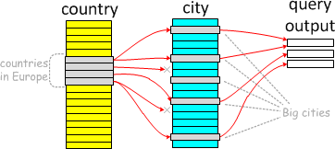
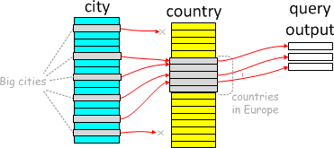
What is Semi-join
A semi-join subquery:
select * from Country
where Continent='Europe' and Country.Code in
(select City.country from City where City.Population>1*1000*1000);
One can execute it "naturally", by starting from countries in Europe and checking if they have populous Cities:
The semi-join property also allows "backwards" execution: we can start from big cities, and check which countries they are in:

Slide 31
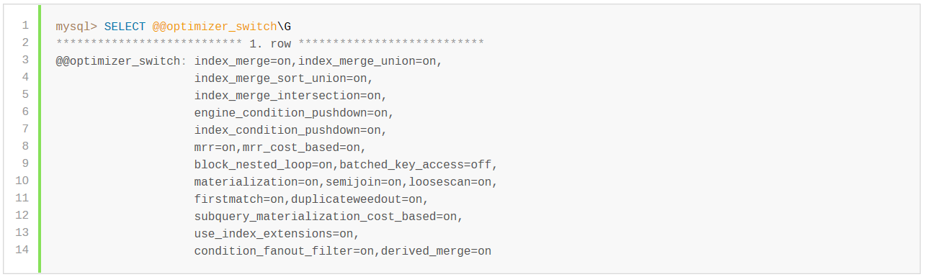
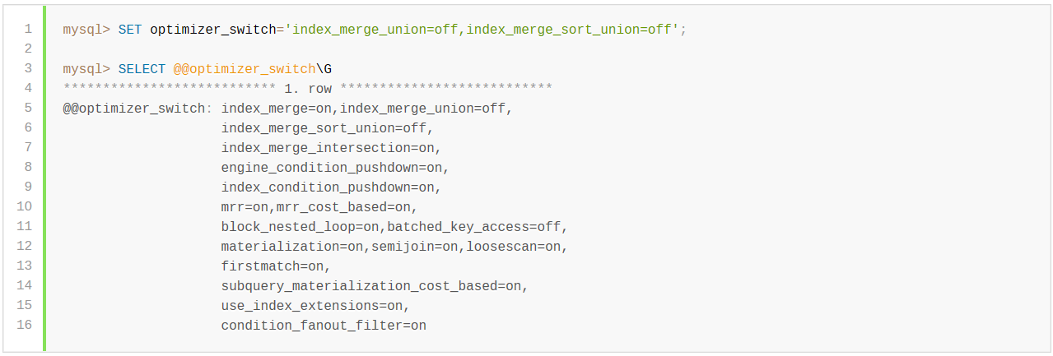
The optimizer_switch system variable enables control over optimizer behavior. Its value is a set of flags, each of which has a value of on or off to indicate whether the corresponding optimizer behavior is enabled or disabled. This variable has global and session values and can be changed at runtime. The global default can be set at server startup.

Slide 32
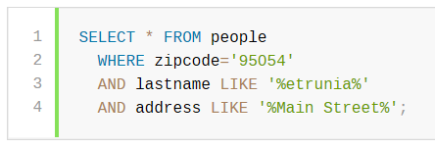
Index Condition Pushdown Optimization
Better to build an Index like this :
INDEX (zipcode, lastname, firstname)
MySQL can use the index to scan through people with zipcode='95054'. The second part (lastname LIKE '%etrunia%') cannot be used to limit the number of rows that must be scanned, so without Index Condition Pushdown, this query must retrieve full table rows for all people who have zipcode='95054'.

Slide 33
Exercise
bms_departmentOutwireNumber
PRIMARY KEY (`id`),
KEY `departmentId` (`departmentId`),
KEY `outwireNumber` (`outwireNumber`),
KEY `trunkId` (`trunkId`) USING BTREE,
KEY `tenantId` (`tenantId`)
bms_onHookMessage
PRIMARY KEY (`id`),
KEY `tenantId_outnum_trunkId` (`tenantId`,`trunkId`,`outwireNumber`) USING BTREE
SELECT
a.tenantId, a.tenantId, a.departmentId, a.outwireNumber, a.trunkId, c.callInMsg, c.callOutMsg, c.callInEnabled, c.callOutEnabled,a.inputTime AS outwireInputTime, c.inputTime,c.modifyTime
FROM
(SELECT * FROM bms_departmentOutwireNumber WHERE departmentId IN(${departmentIds})) a
INNER JOIN
bms_onHookMessage c
ON ( c.tenantId = a.tenantId
AND c.outwireNumber = a.outwireNumber
AND c.trunkId = a.trunkId
AND c.callInMsg LIKE CONCAT('%', '会计', '%')
AND c.callOutMsg LIKE CONCAT('%', '98798', '%')
)
WHERE
a.tenantId = '880001' ORDER BY a.outwireNumber ASC LIMIT 0,15

Slide 34
Database Design Objectives
Achieve what you want to do
Save your development time and reduce potential bugs after production
Increase application maintainability
Ensure good system performance after production
Space saving may not be first priority

Slide 35
Physical Design – some hints
Select Data from TableB
where Key = :A and Type = :B
Design your database which can be easily retrieved and updated by SQL
Vertical Layout
Select col2 from TableA where Key=‘K1’
Select col3 from TableA where Key=‘K3’
Key Type Data
K1 Col1 Data11
K1 Col2 Data12
K1 Col3 Data13
K2 Col1 Data21
K2 Col2 Data22
K2 Col3 Data23
K3 Col1 Data31
K3 Col2 Data32
K3 Col3 Data33
Horizontal Layout
Key Col1 Col2 Col3
K1 Data11 Data12 Data13
K2 Data21 Data22 Data23
K3 Data31 Data32 Data33
VS

Slide 36
Physical Design – some hints
Avoid too rigorous table normalization in your physical design
Table Employee
Grade Id Grade Nam
J1 Joiner 1
J2 Joiner 2
J3 Joiner 3
J4 Joiner 4
J5 Joiner 5
S1 Senior 1
S2 Senior 2
Depart Id Col1 Col2 Col3 Grade
K1 Data11 Data12 Data13 Joiner 1
K2 Data21 Data22 Data23 Senior 1
K3 Data31 Data32 Data33 Joiner 1
K4 Data31 Data32 Data33 Joiner 1
K5 Data31 Data32 Data33 Joiner 2
K6 Data31 Data32 Data33 Joiner 2
K7 Data31 Data32 Data33 Senior 1

Slide 37
Physical Design – some hints
Normalization VS Demoralization
De-normalization
Less table join operations
More space allocation
Better performance
Normalization - Save space
Less space allocation
Single point of modification
More easy to understand

Slide 38
Physical Design – some hints
Use Trigger and Stored Procedure
Trigger
Good for audit trail and transaction log
Simple and strict forward data integrity control
Stored Procedure
Good for complicated business logic
Reduce network traffic
Centralize business logic

Slide 39
Physical Design – some hints
Transaction Log should be designed by Trigger with log table
Master Table
Key Col1 Col2 Col3 Updated by Timestamp
K1 Data11 Data44 Data13 User1 date1
K2 Data21 Data22 Data23
K3 Data31 Data32 Data55 User2 date2
Trigger for update
Log Table – before image
Key Col1 Col2 Col3 Updated by Timestamp
K1 Data11 Data12 Data13 User1 date1
K3 Data31 Data32 Data33 User2 date2

Slide 40
Physical Design – some hints
Null & Data Integrity
Avoid using NULL as an indicator
Referential integrity - Foreign key, Primary key and constraints
select * from B
where B.f1 not in (select A.f1 from A);
B has a Null record in B.f1
A.f1 | B.f1
X | null
X | X

Slide 41
Physical Design – some hints
Design re-executable long batch processes !
Don’t rely on Rollback Segment for your long batch process recovery after interruption
Design you long batch job which can be re-executed after interruption
Batch Start
Temporary Data1
Temporary Data2
Last update to
Permanent tables
1
2
3
Interrupt and restart Point

Slide 42
Physical Design – some hints
Pros and Cons of using view ?
Simplify data structure and improve productivity
Improve security control
Degrade performance due to the adding overhead of database internal optimizer

Slide 43
Physical Design – Last hints
Simple is the best
Procedures
Procedures
Procedures
Procedures
Procedures
Procedures
Procedures
Procedures
Database
Database

Slide 44
Coding – some hints
Use SQL instead of PL/SQL
Procedure print_daily_deal is
cursor deal_cursor is
select cust_code, qty, price, amount
from deal;
begin
for dd in deal_cursor loop /* implicit open and fetch */
select cust_name from customer
where cust_code = dd.cust_code;
print cust_name, qty, price, amount (pseudo code);
end loop;
end print_daily_deal;
select cust_name, cust_code, qty, price, amount
from deal, customer
where deal.cust_code=customer.cust_code;

Slide 45
Coding – some hints
Tools for PL/SQL development
Graphical Interface SQL development environment can normally bring you 50% productivity gain
SQL*Plus Oracle 8.0.6
Oracle Procedure Builder Oracle 6.0.8.10
PL/SQL Developer
RapidSQL Embarcadero Technologies
XPEDITER/SQL Compuware/NuMega
Navicat

Slide 46
Thanks

Slide 47
ORDER BY clause
Use concatenated index.
If A table is indexed with lastname, firstname.
Replace
SELECT * FROM A
WHERE lastname = 'Smith'
ORDER BY firstname
With
SELECT * FROM A
WHERE lastname = 'Smith'
ORDER BY lastname, firstname

Slide 48
Complex SQL Transformation
select * from A
where (A.key1,A.key2)
not in
(select B.key1,B.key2 from B)
Sometimes the following transformation may give you surprise !
select * from A
where (A.key1,A.key2) in
(select B.key1,B.key2 from B
minus
select A.key1,A.key2 from A)
Notes:
JM

